Slide 1
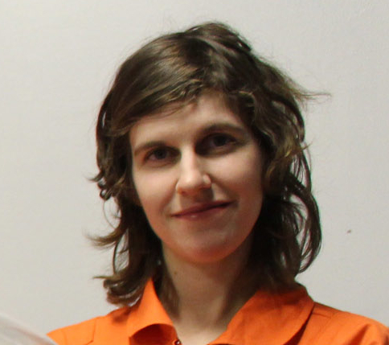
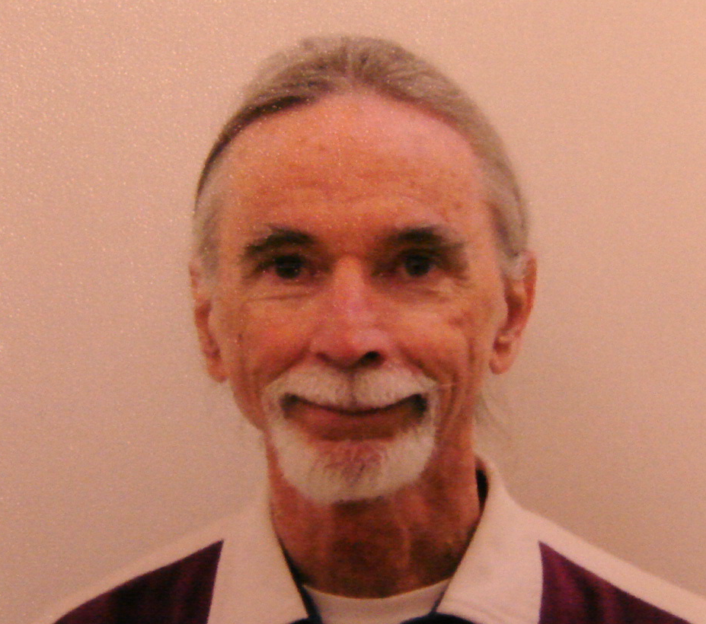
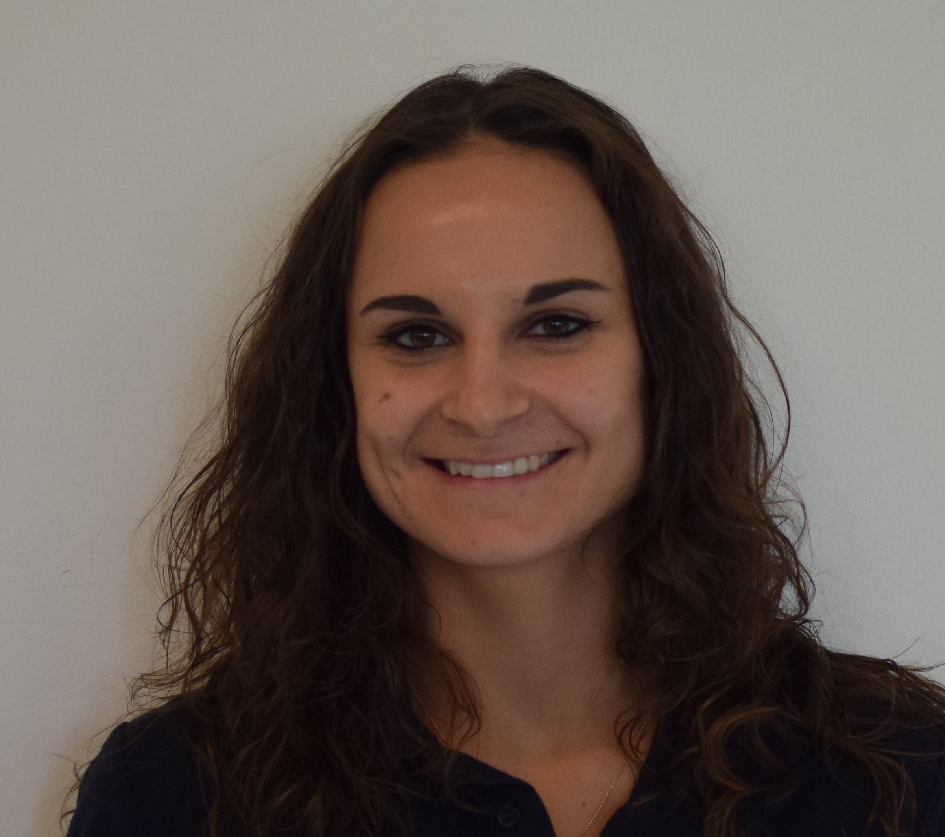
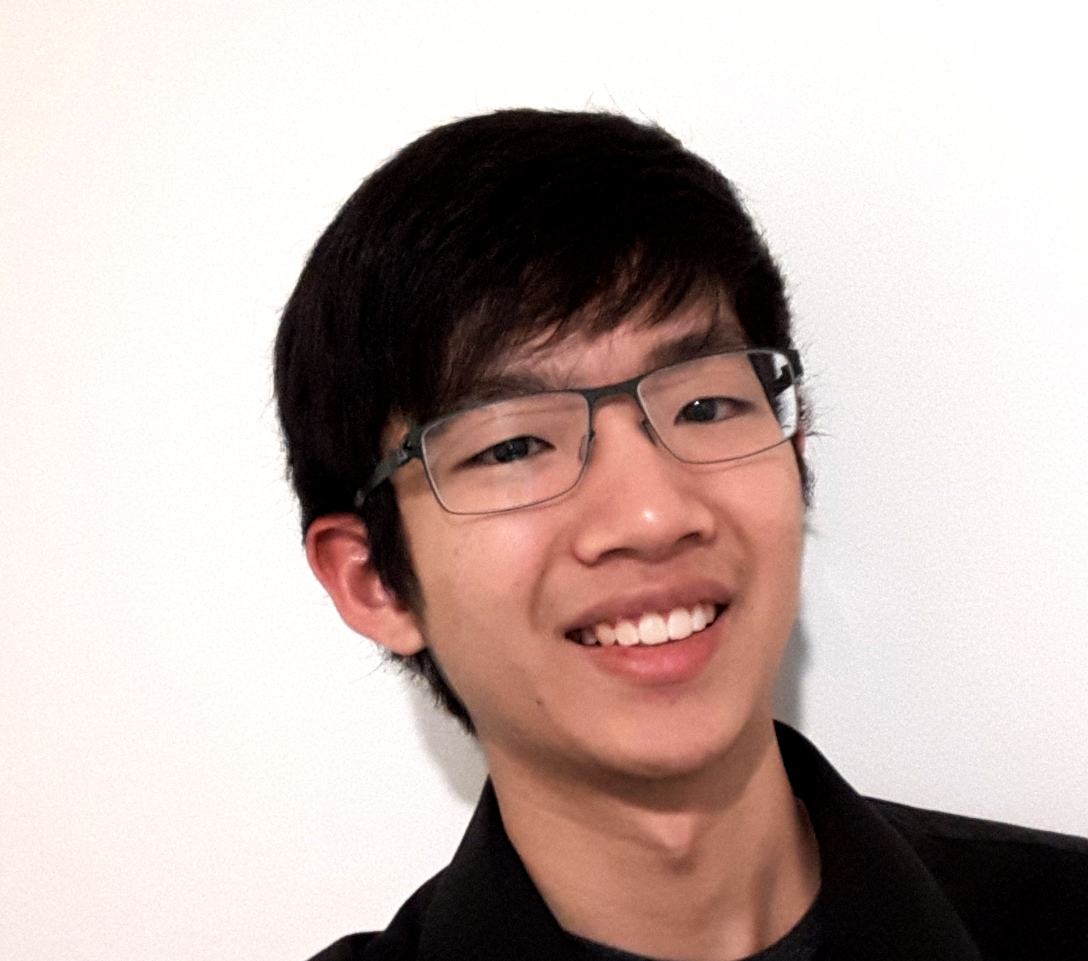
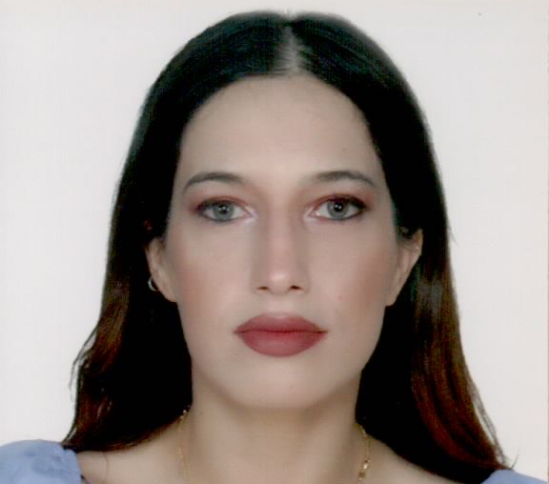
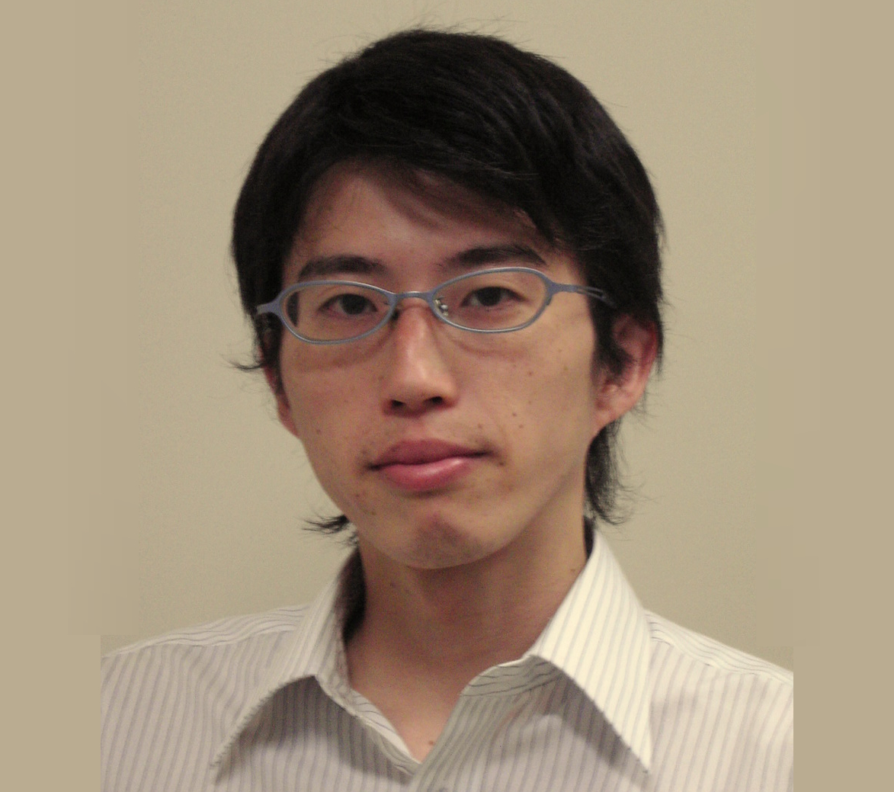
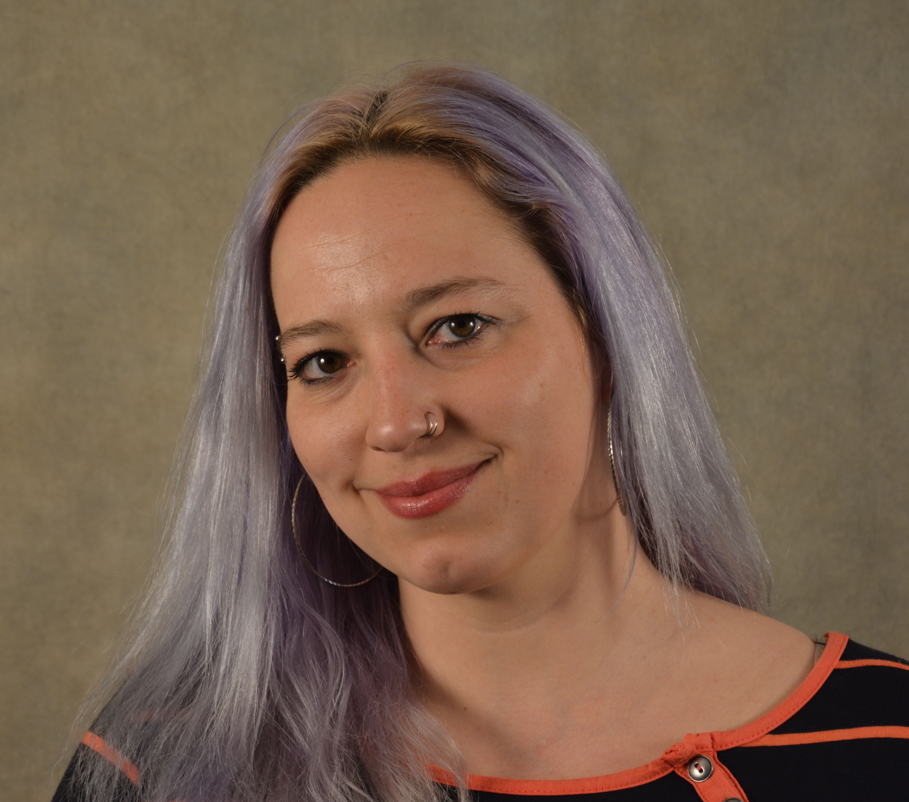
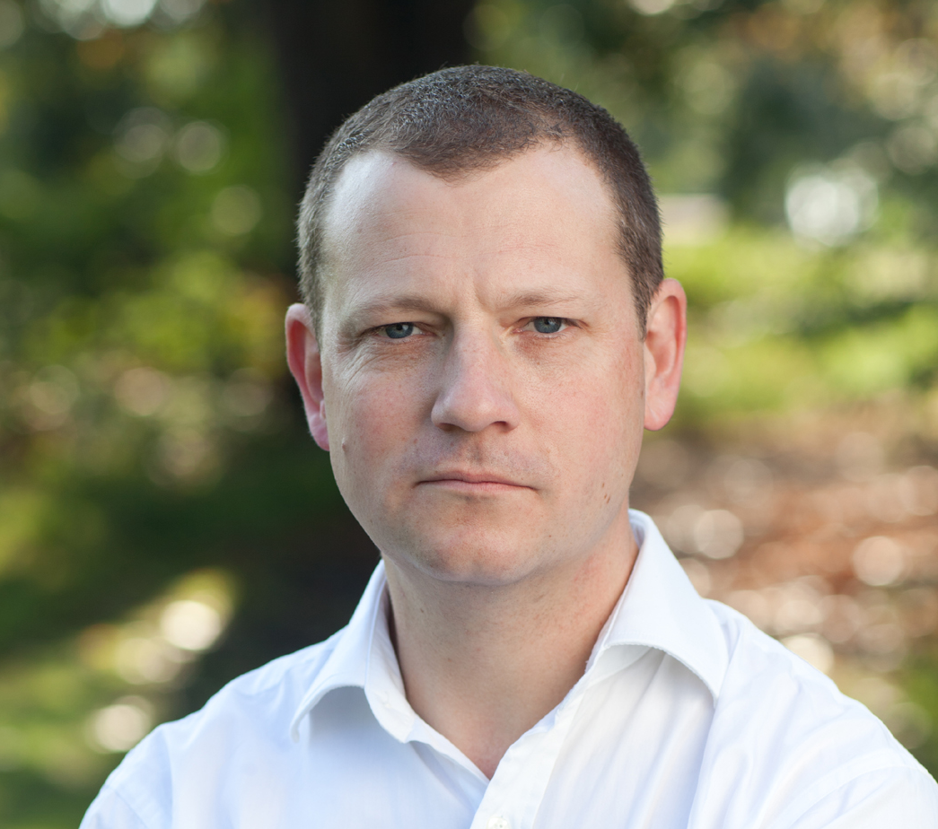








Meet the Areonauts
Lindsay Rutter, PhD
Mission Commander
JSPS Postdoctoral Fellow, Tsukuba University
Ludovica Valentini
Crew Engineer
Aerospace Engineer, OHB Sweden
Charikleia Olympiou, MD
Crew Health and Safety Officer
Cardiologist
David Laude
Executive Officer
Microelectronics Engineer
Inga Popovaite
Crew Scientist
PhD Student, University of Iowa
Jin Sing Sia
Crew Engineer
BASc Student, University of Waterloo
Yuzo Shibata
GreenHab Officer
Independent Adviser
Stuart Hughes
Crew Journalist
Journalist, BBC
- Multi Terris, Unus Finis -

